Slide 1
How to increase the revenue of Big Mountain resort by next season

Slide 2
Agenda
Current pricing strategy
Price affecting features
Position of Big Mountain in the market segment
Possible Recommendations
Conclusion

Slide 3
Big Mountain Resort – Current scenario
The current ticket prices of Big Mountain resort are $81
The current pricing strategy is to charge a premium above average ticket prices of other resorts in the market
Big Mountain is not capitalizing on its facilities to the fullest

Slide 4
Most price affecting Features
Summit Elevation
Vertical Drop
Base elevation
Trams
Fast sixes
Fast Quads
Quad
Triple
Double
Surface
Total Chairs
Runs
Terrain Parks
Longest Run
Skiable Terrain
Snow Making area
Days open last year
Years open
Average snowfall
Ticket Price
Night Skiing area
Resorts per state
There are around 22 features that are considered for a skiing resort, out of which, most price affecting features are:
Vertical Drop
Fast Quads
Runs
Total number of chairs
Snow making area

Slide 5
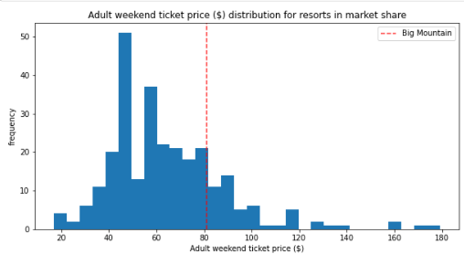
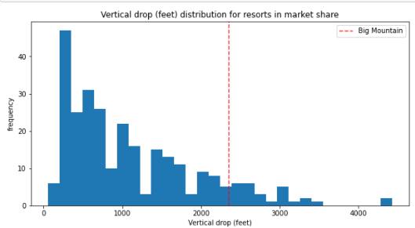
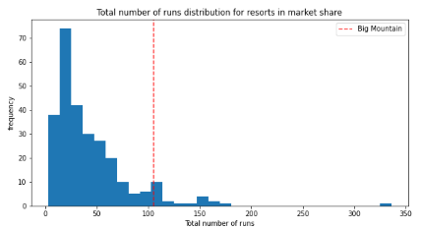
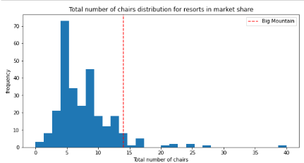
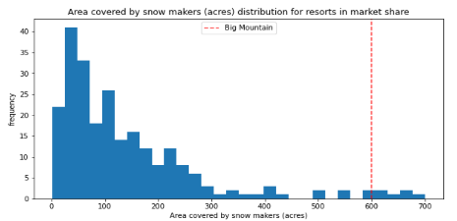
Where Big Mountain stands with respect to other resorts:
Ticket Price
Vertical Drop
Total Runs
Total Chairs
Snow covered area

Slide 6
Possible recommendations
Closing 2 least used runs can drop ticket prices by $0.40
Closing 5 least used runs can drop ticket prices by $0.75
Adding 1 run, increasing vertical drop by 150ft and installing a chair lift will increase the ticket prices by $1.99 and revenue by $3,474,638
Adding 1 run, increasing vertical drop by 150ft, additional chair lift and 2 acres of additional snow making area will increase the ticket prices by $1.99 and revenue by $3,474,638
Increasing longest run by 0.2 miles and adding 4 acres of snow making area makes no changes on ticket prices

Slide 7
Conclusion
Big Mountain can raise the ticket prices by $1.99
Closing 5 least used runs to reduce any maintenance cost needed for these 5 runs
Increasing the vertical drop by 150 feet
Adding a run and a chair lift with access to the elevated vertical drop
Considering the operating cost of $1,540,000 for additional chair lift, the revenue by next season can be increased by $1,934,638

